Slide 1
Cannery Report 2019
Gilmer County Schools

Slide 2
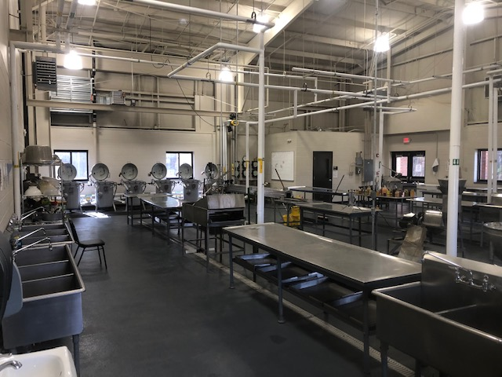
Preparation

Slide 3
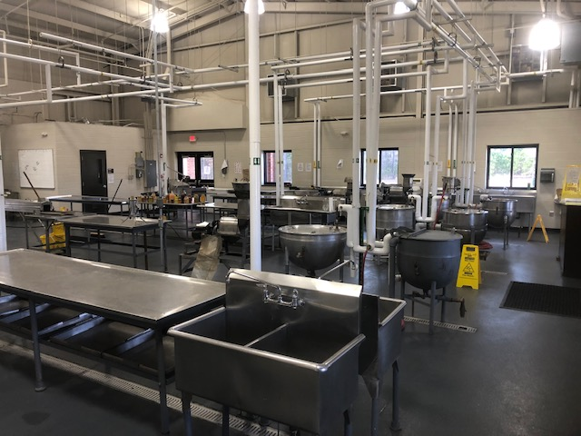
Preparation

Slide 4
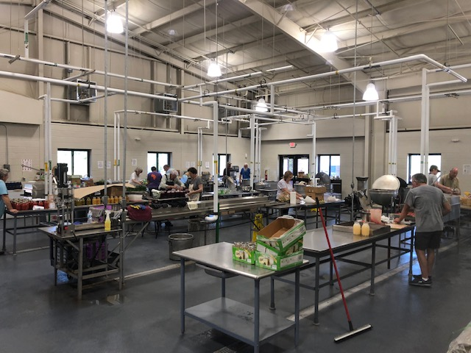
Production

Slide 5
Annual Report
Number of Days Operated in the Summer of 2019 | 45
Number of Days Operated All Year | 105
Number of Units Canned | 17,610
Number of Units Prepared for Freezing | 220
Number of Bushels Shelled | 26
Percentage of Processed Products “Homegrown” | 82
Pounds of Meat Processed | 0
Total Number of Visits | 1,709
Number of Students Provided with Food Processing Center Instruction | 433

