Slide 1
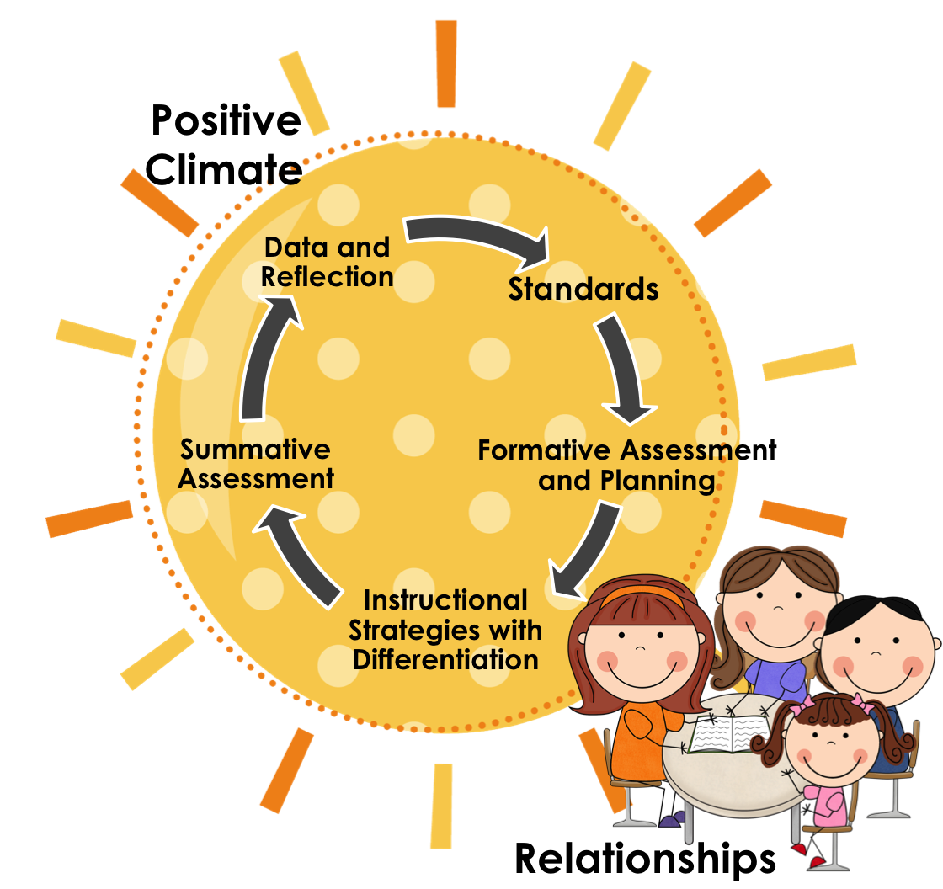
EPS PLC’S (PROFESSIONAL LEARNING COMMUNITIES)

Slide 5
What are Professional Learning Communities (PLC’s)?
A continuous focus on learning to determine a systematic response that ensures support for every student, every day!
Track student progress and assess what worked well and what did not
Collaborative culture
Data drive and Results oriented
Share effective strategies
Develop common assessments
Determine resources/professional development needed for success
Accountability – weekly PLC’s are held at EPS
*Developing Meeting Norms – share process
*Model a mini PLC meeting – Kindergarten Teachers

Slide 6
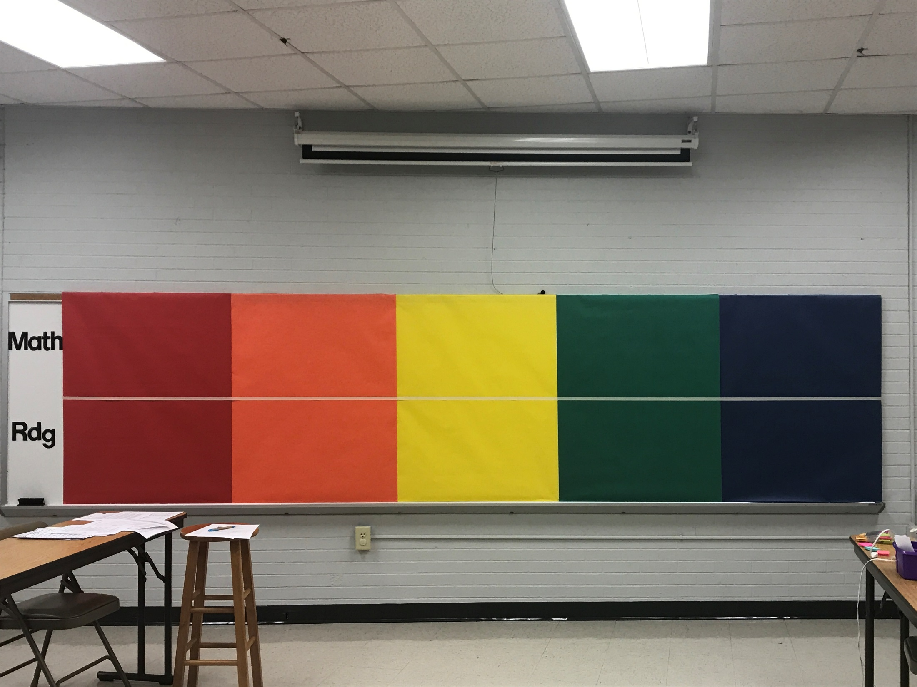

Slide 7
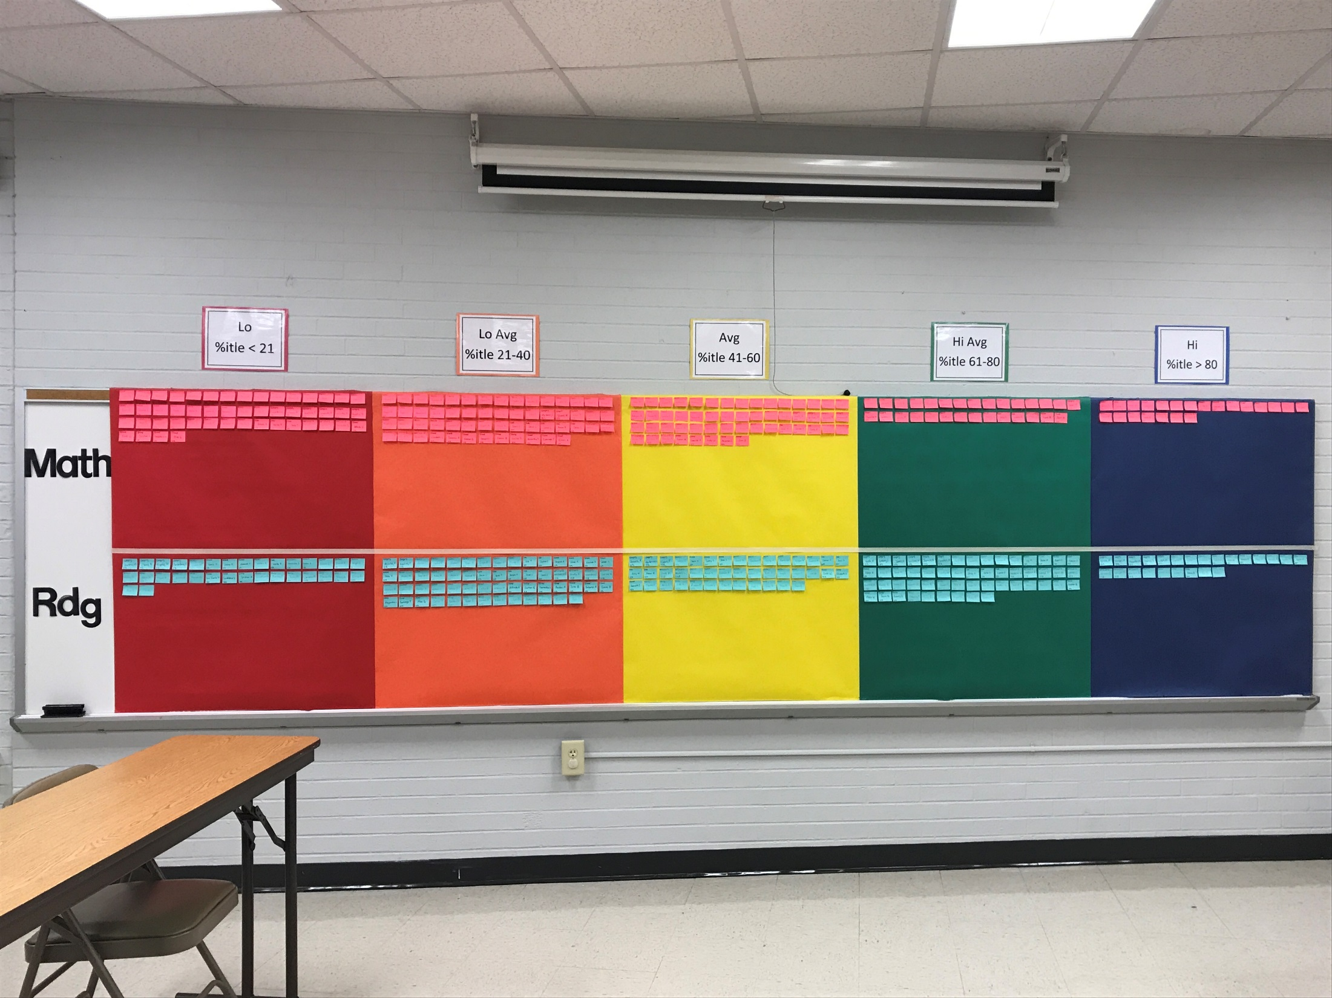

Slide 8
